Slide 1
NSFW Content Detection and Mitigation with Python

Slide 2

Slide
Title: NSFW Content Detection and Mitigation with Python

Slide 3

Introduction to NSFW Detection
Python offers powerful tools for NSFW content detection and mitigation.
Focus on images and videos using extensive libraries.
Analyze visual features to identify potentially offensive material.

Slide 4

Key Libraries for NSFW Detection
TensorFlow/PyTorch: Deep learning model framework.
OpenCV: Image processing library.
`nsfw_detector`: Specialized NSFW filtering package.

Slide 5

Understanding `nsfw_detector`
Pre-trained convolutional neural network (CNN) model.
Often based on ResNet architecture.
Classifies images into categories (safe, suggestive, explicit).

Slide 6

Benefits of Pre-trained Models
Reduces development time and resource needs.
Already trained on large datasets of labeled images.
Ready for immediate deployment.

Slide 7
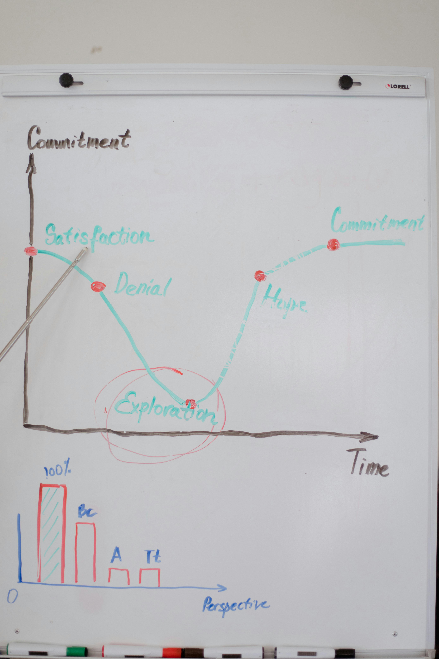
Custom NSFW Detector Development
Collect and label custom datasets.
Tailor to specific content types or sensitivity levels.
Provides flexibility for specific needs.

Slide 8

Training a Custom Model
Select an appropriate CNN architecture.
Fine-tune pre-trained weights for transfer learning.
Data augmentation improves robustness and generalization.

Slide 9

Image Preprocessing Importance
Resizing images to a standard size.
Normalizing pixel values.
Edge/face detection focuses the model.

Slide 10

Model Evaluation Metrics
Precision: Minimize false positives.
Recall: Minimize false negatives.
F1-score: Balance precision and recall.

Slide 11

Mitigation Strategies
Blur or remove NSFW images automatically.
Provide content warnings to users.
Implement age verification systems.

Slide 12

Code Example
from nsfw_detector import predict
model_path = 'nsfw_model/open_nsfw-weights.29-0.96.hdf5'
image_path = 'example.jpg' # Replace with path to your image
try:
predictions = predict.classify(model_path, image_path)
if predictions:
print(predictions)
else:
print("No predictions generated.")
except FileNotFoundError:
print(f"Error: Image file not found at {image_path}")
except Exception as e:
print(f"An error occurred: {e}")

Slide 13
Code Example
from nsfw_detector import predict model_path = 'nsfw_model/open_nsfw-weights.29-0.96.hdf5' image_path = 'example.jpg' # Replace with path to your image try: predictions = predict.classify(model_path, image_path) if predictions: print(predictions) else: print("No predictions generated.") except FileNotFoundError: print(f"Error: Image file not found at {image_path}") except Exception as e: print(f"An error occurred: {e}")

Slide 14
Code Example
from nsfw_detector import predict model_path = 'nsfw_model/open_nsfw-weights.29-0.96.hdf5' image_path = 'example.jpg' # Replace with path to your image try: predictions = predict.classify(model_path, image_path) if predictions: print(predictions) else: print("No predictions generated.") except FileNotFoundError: print(f"Error: Image file not found at {image_path}") except Exception as e: print(f"An error occurred: {e}")

Slide 15
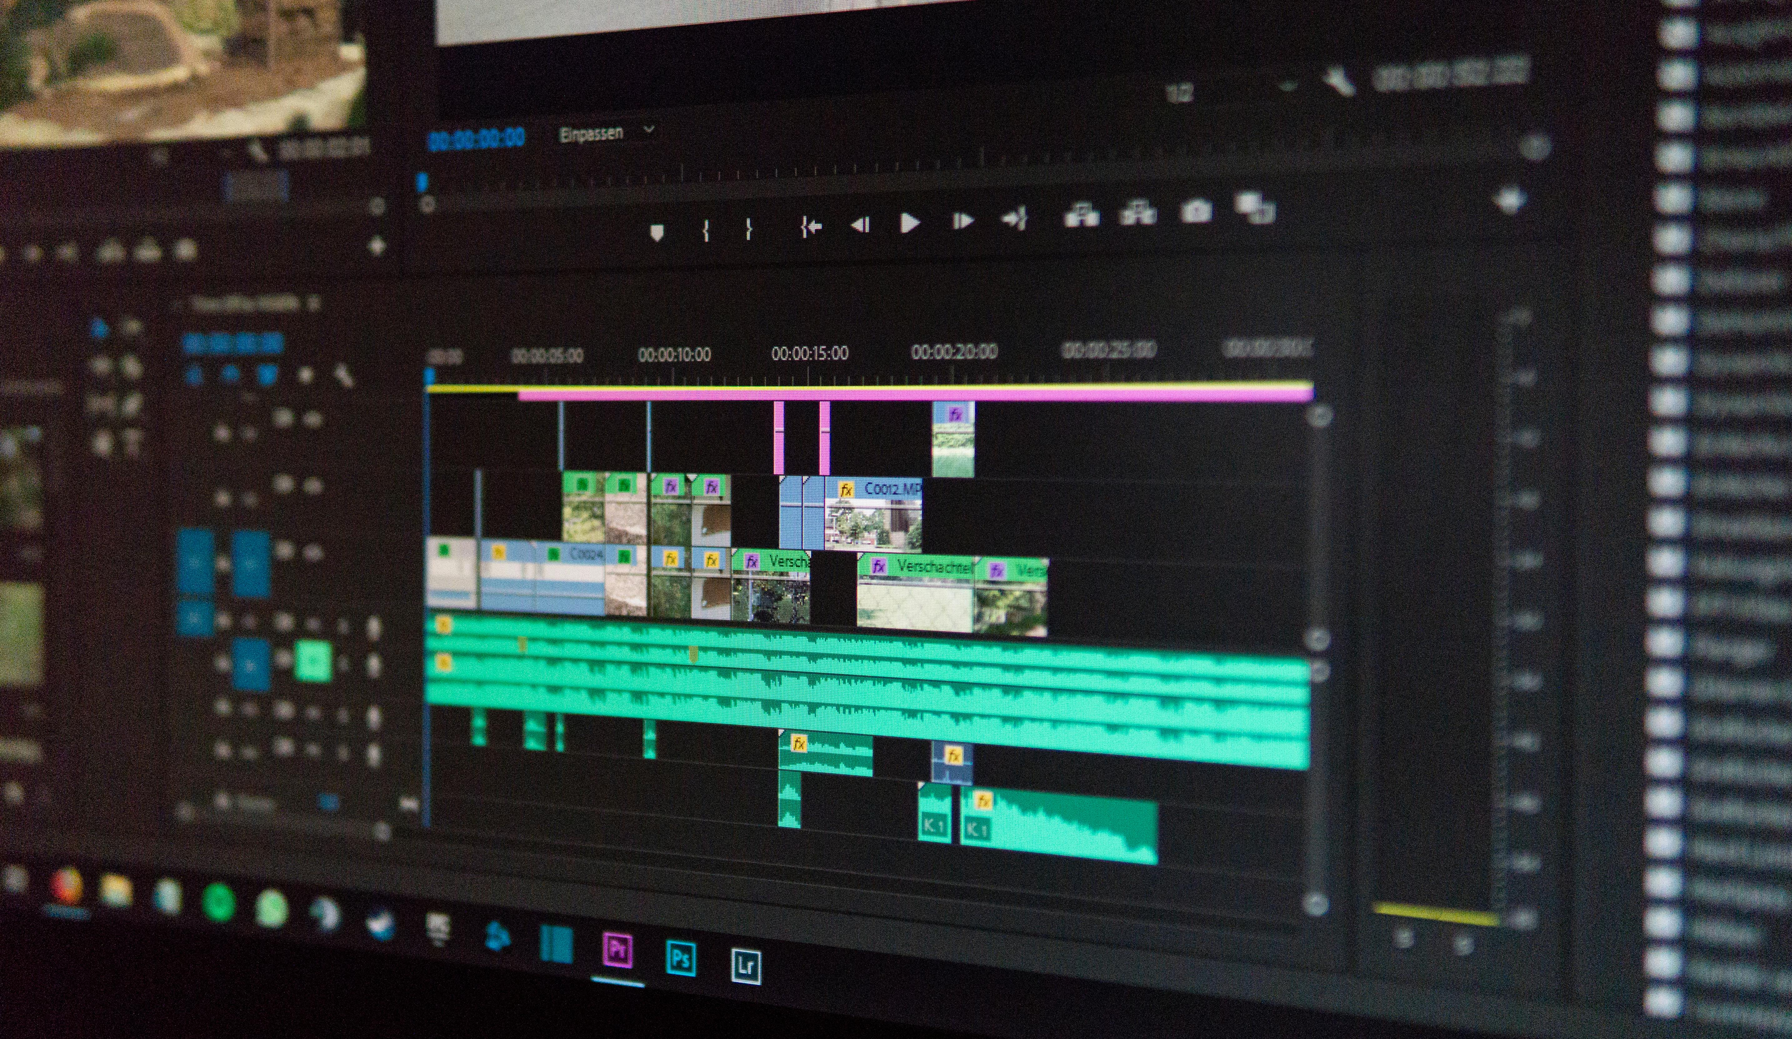
Web Application Integration
Integrate Python script into backend frameworks (Flask, Django).
Process uploaded images/videos before display.
Important for real-time filtering.

Slide 16
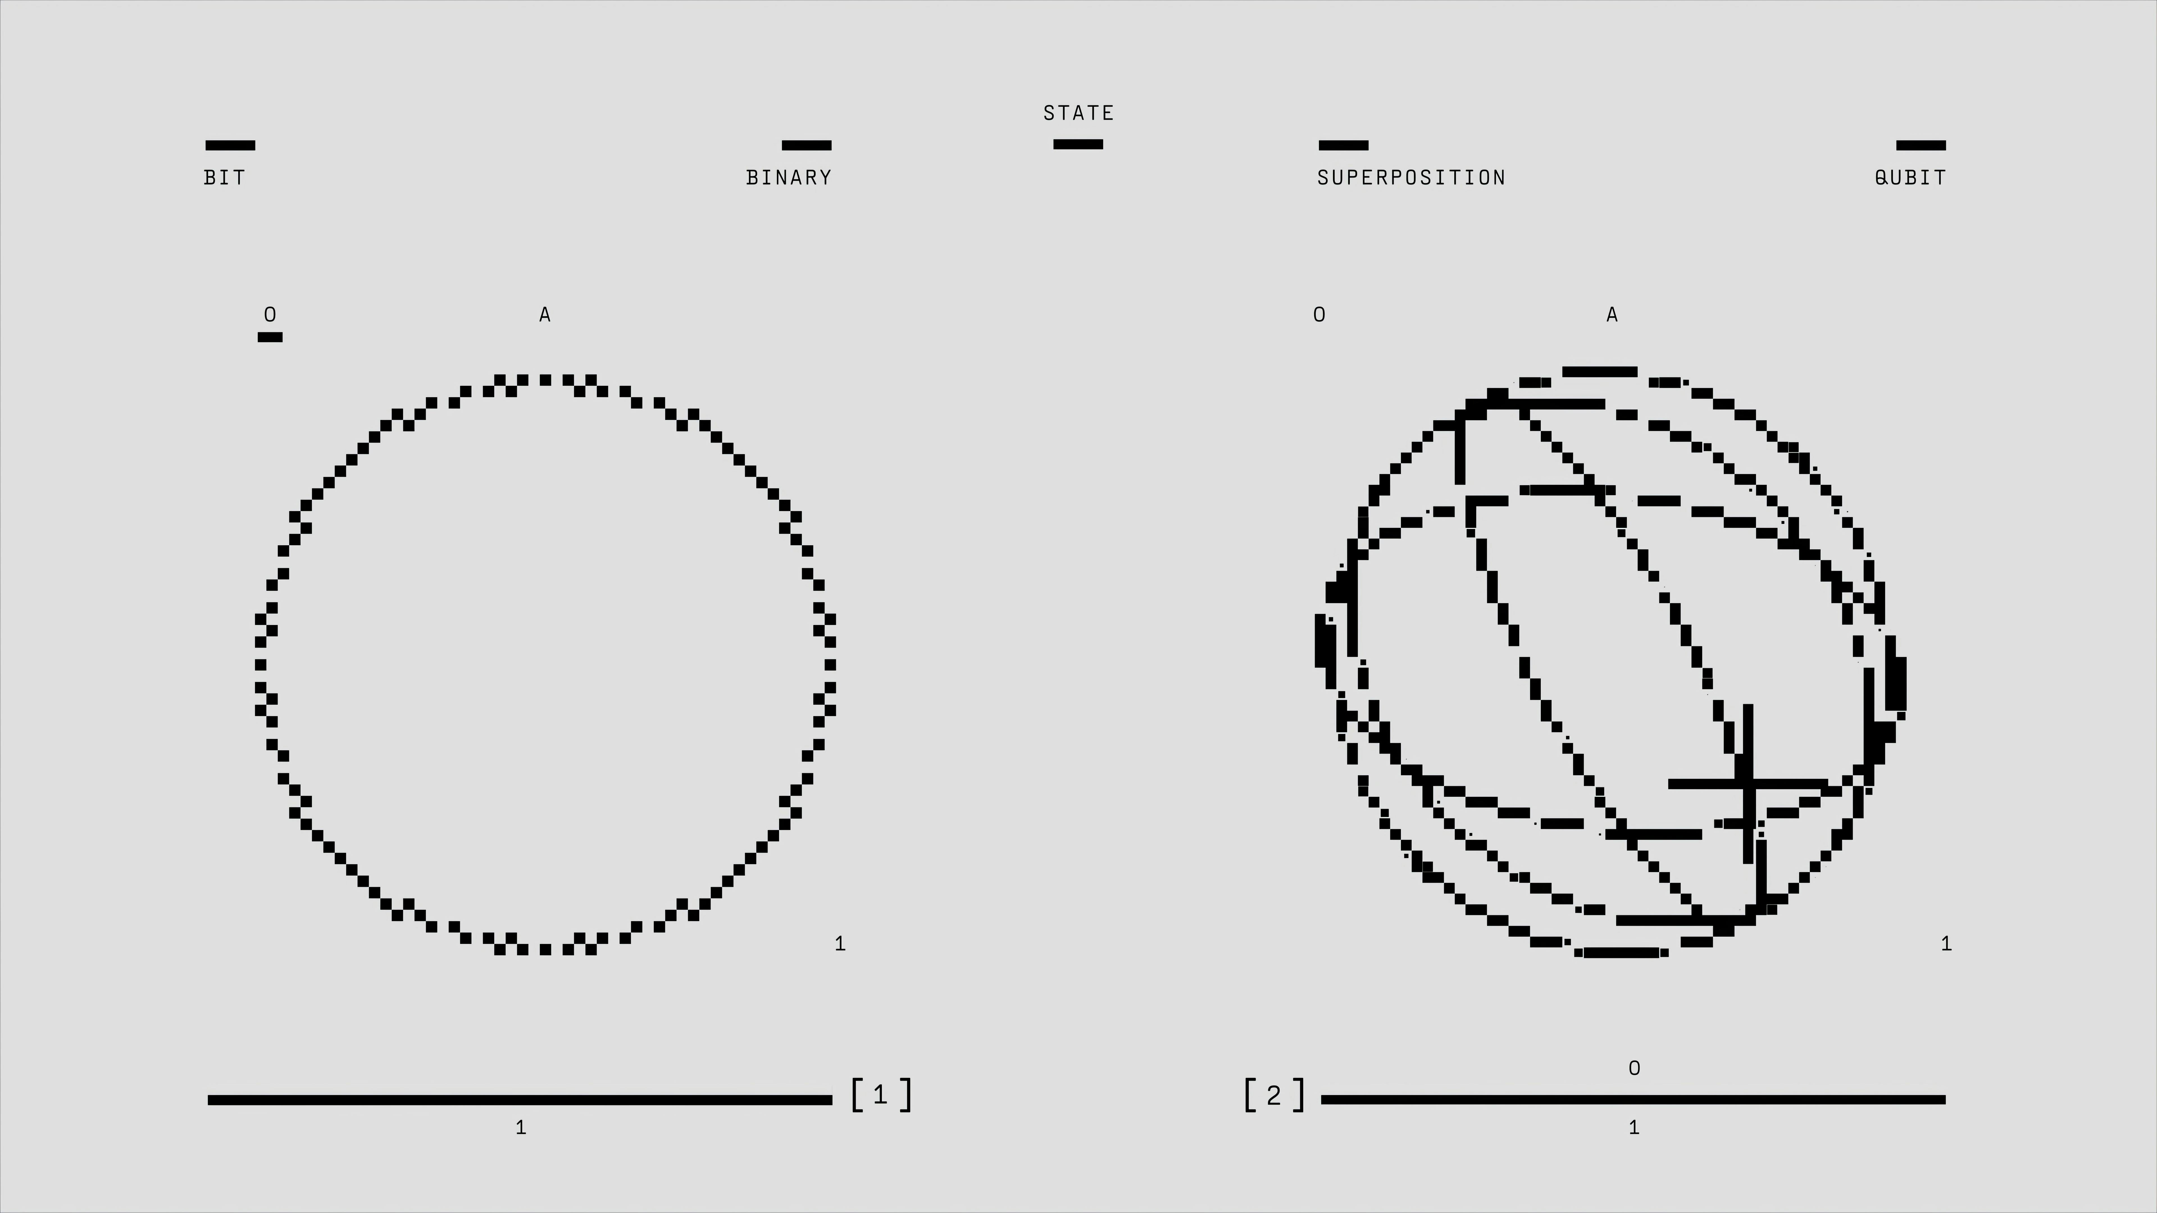
Performance Optimization
Detection can be computationally intensive.
Batch processing and asynchronous tasks improve speed.
GPU acceleration provides a significant boost.

Slide 17
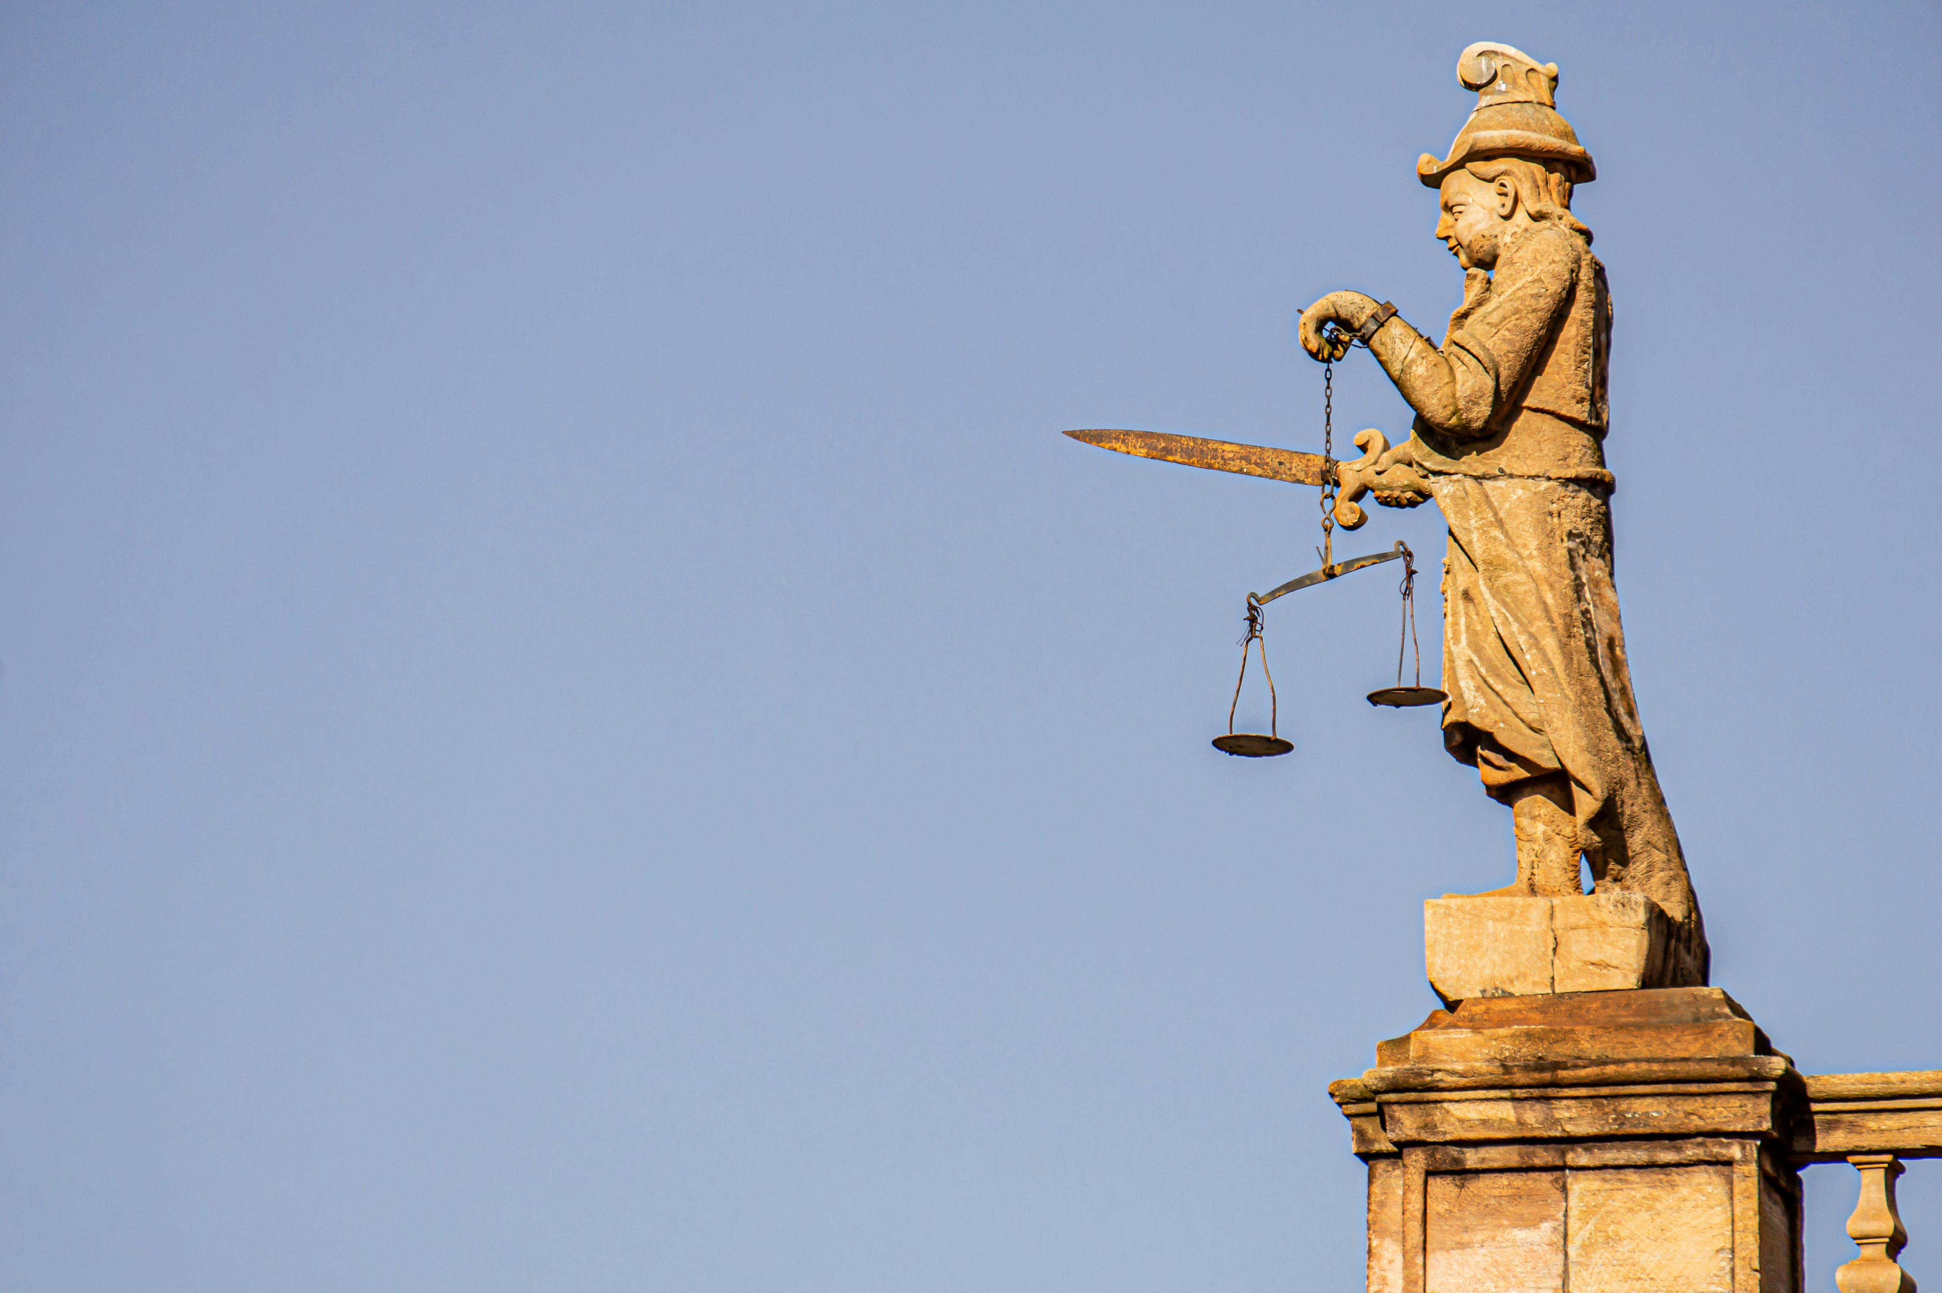
Video Content Analysis
Perform NSFW detection on a frame-by-frame basis.
Analyze a representative set of frames.
Estimate the overall NSFW score of the video.

Slide 18
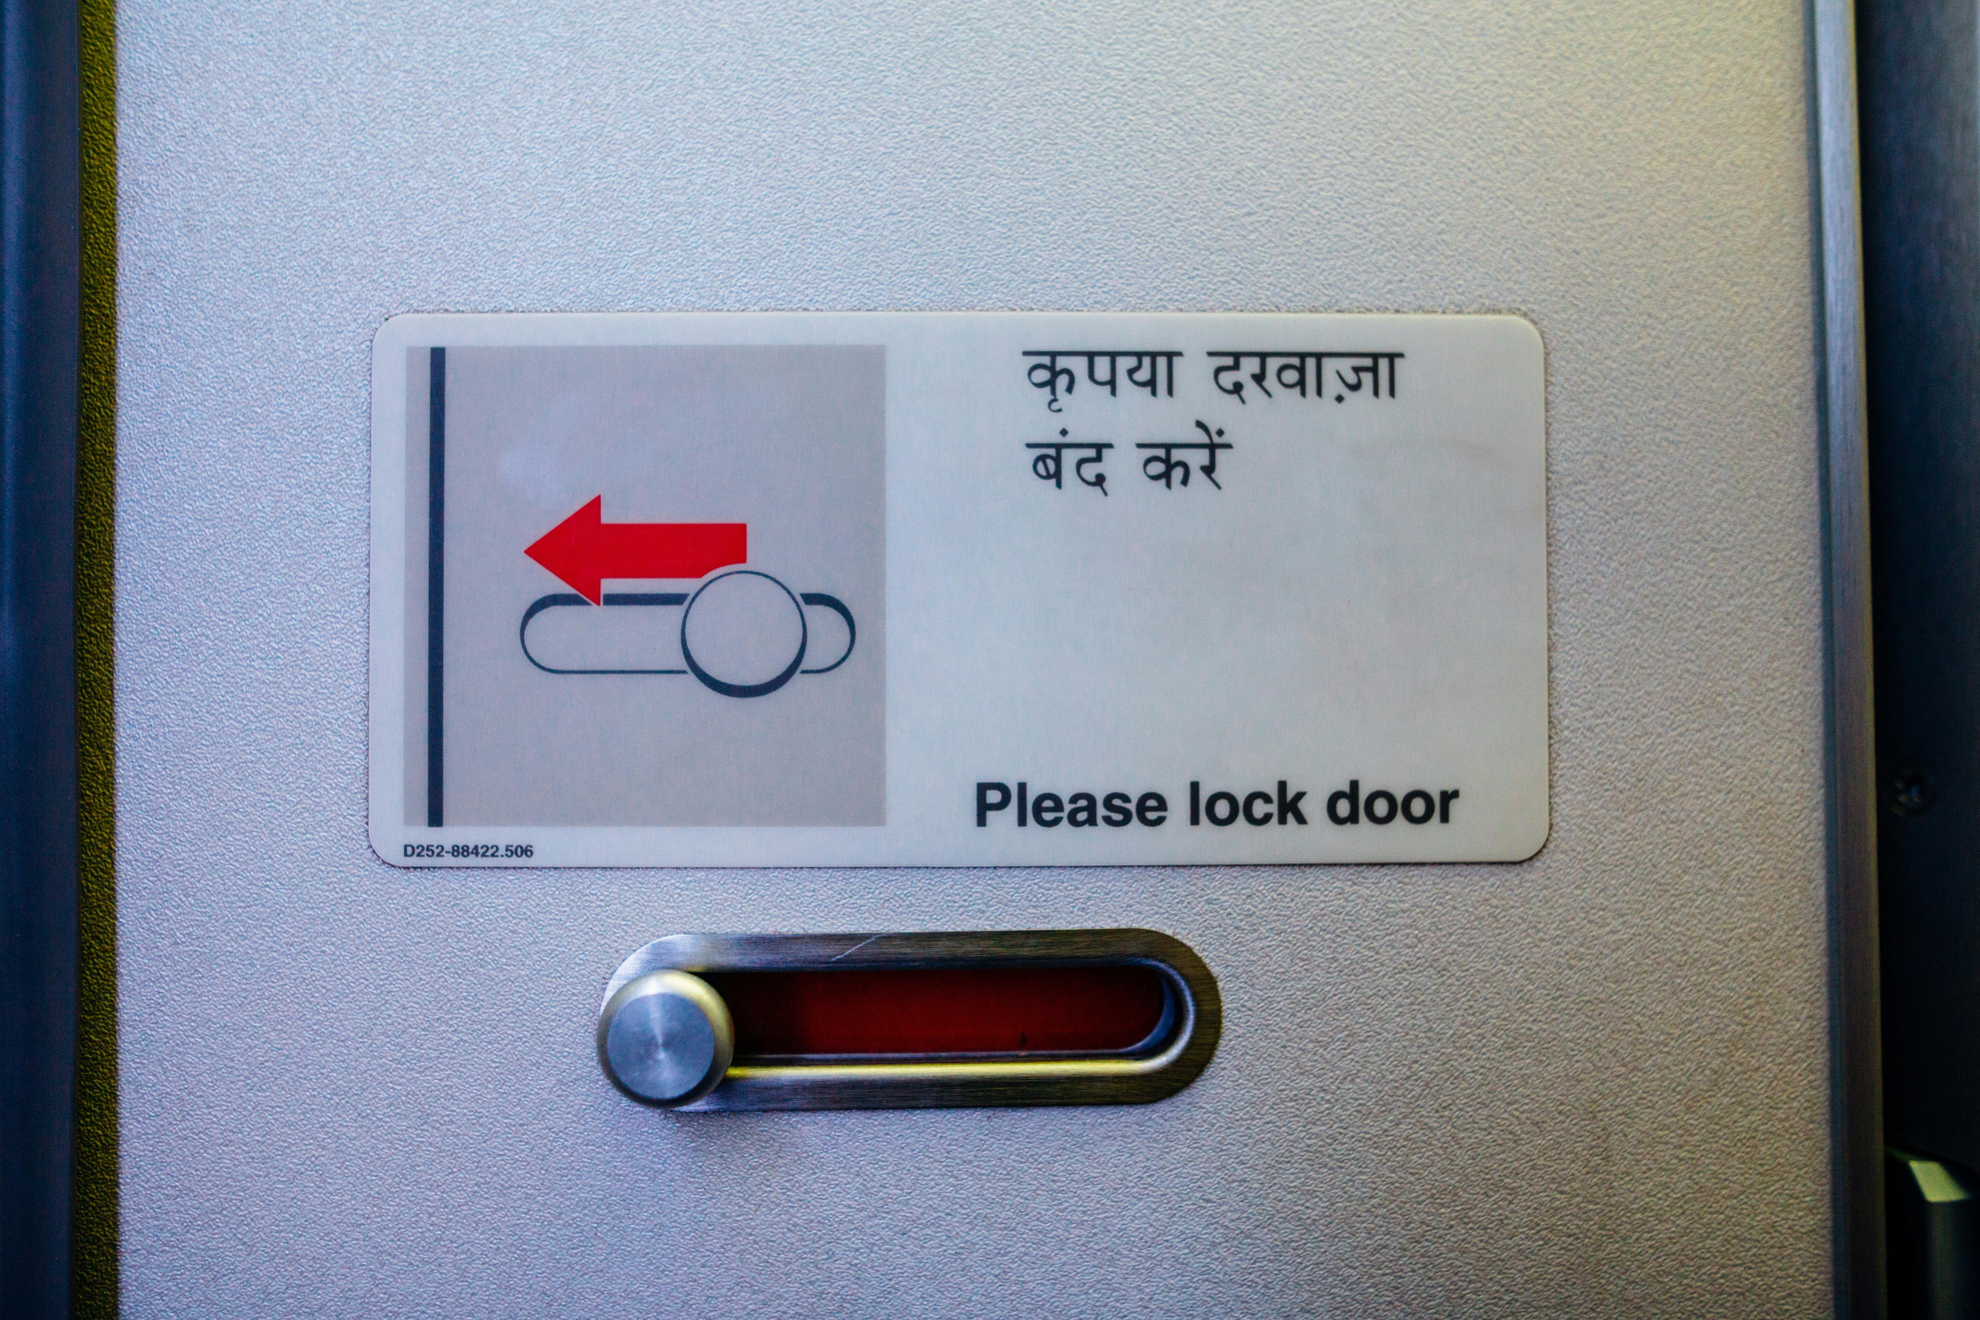
Preventing Filter Circumvention
Robust input validation and sanitization are crucial.
Prevent users from manipulating image data or metadata.
Ensure accurate and reliable results.

Slide 19

Ethical Considerations
Technology can be used for censorship or unfair targeting.
Careful consideration of bias in training data.
Assess potential for unintended consequences.

Slide 20

Adjusting NSFW Thresholds
Threshold for "NSFW" is configurable.
Adaptable to different community standards and legal requirements.
High thresholds for high sensitivity.

Slide 21

Addressing Adversarial Attacks
Individuals craft images to fool detectors.
Poses a continuous challenge.
Requires ongoing research and model refinement.

Slide 22

Advanced Techniques
Ensemble methods (combining multiple models).
Active learning (iterative improvement).
Enhance detection accuracy and resilience.

Slide 23
Feature Extraction Libraries
Libraries like Scikit-image provide image processing.
Used for feature extraction.
Improves performance alongside Deep Learning.

Slide 24
Content Moderation Integration
Integration with content moderation systems.
Automatically flag and review potentially inappropriate material.
Contributes to a safer online environment.

